Slide 1


LoRaWAN Water Meter Connectivity: Analysis & Prediction
Identifying and Predicting At-Risk Smart Water Meters

Slide 2
Dataset Attributes (5,000 meters) of LoRaWAN Water Meters
Identifier: MeterID
Location: Latitude, Longitude
Installation Factors:
  DistanceToNearestGateway_m: How far the meter is from the network gateway.
  Depth_mm: How deep the meter is installed.
  LidType: The material of the chamber lid (Plastic, Composite, Cast Iron).
Signal Characteristics (LoRaWAN):
  RSSI_dBm: Received Signal Strength Indicator.
  SNR_dB: Signal-to-Noise Ratio.
  SpreadingFactor: A setting that balances data rate and range.
Performance Metrics:
  DSR_percent: The key performance metric (Data Success Rate).

Slide 3
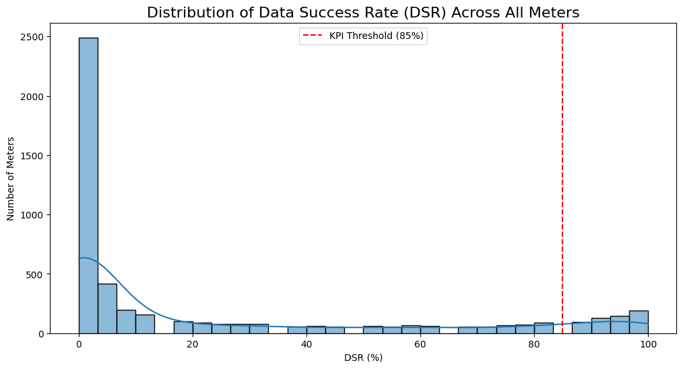
Summarised distribution of DSR across all meters.

Slide 4
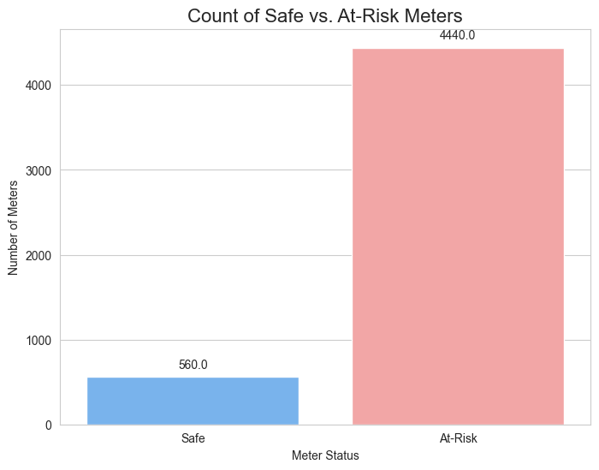
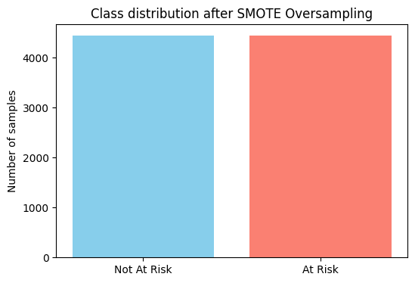
Proportion of Binary Class (Target Value)

Slide 5
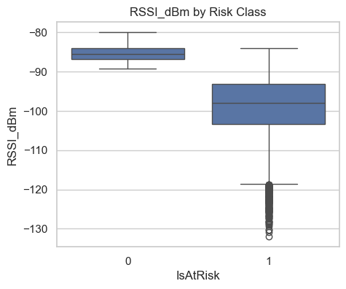
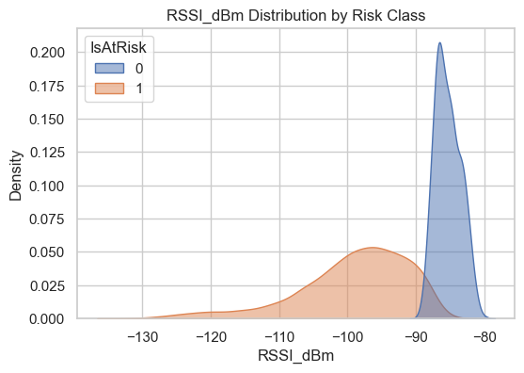
RSSI_dBm Distribution over each class

Slide 6
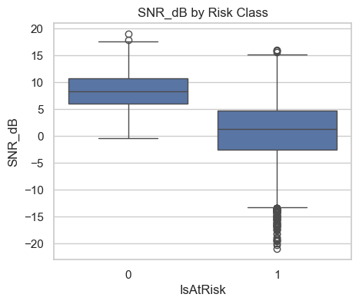
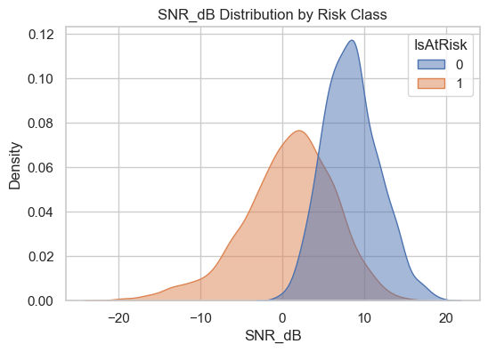
SNR_dB Distribution over each class

Slide 7
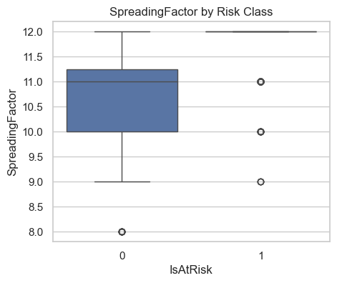
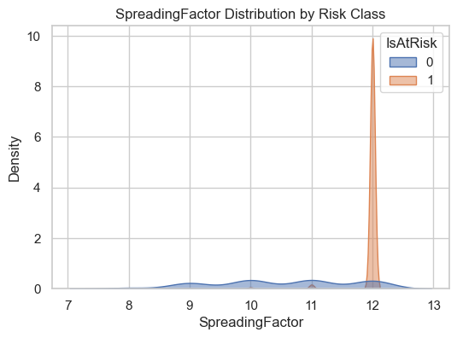
SpreadingFactor Distribution over each class

Slide 8
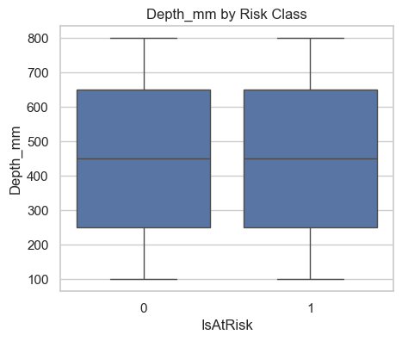
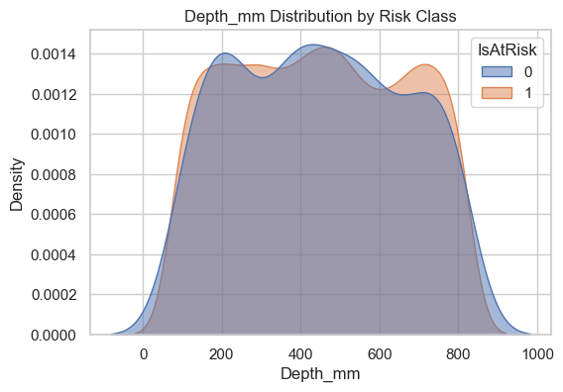
Depth_mm Distribution over each class

Slide 9
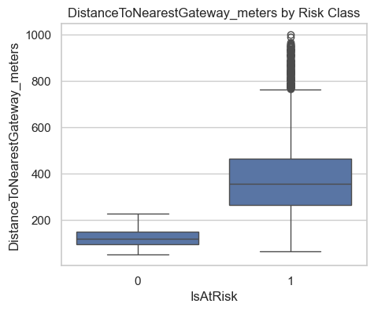
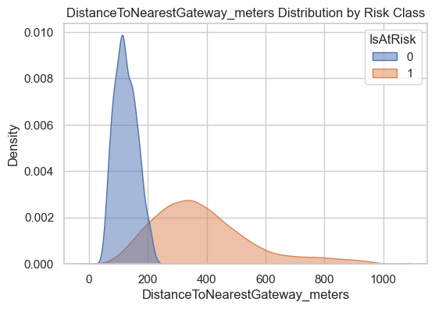
DistanceToNearestGateway_meters Distribution over each class

Slide 10
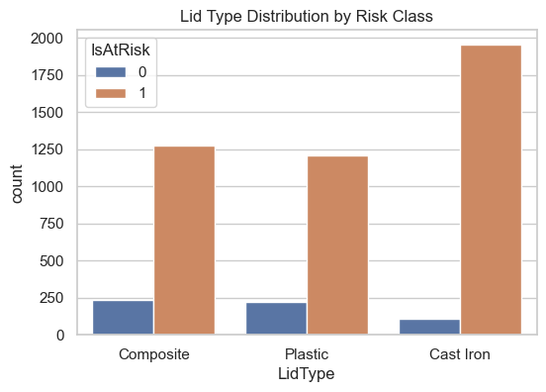
LidType Distribution over each class

Slide 11
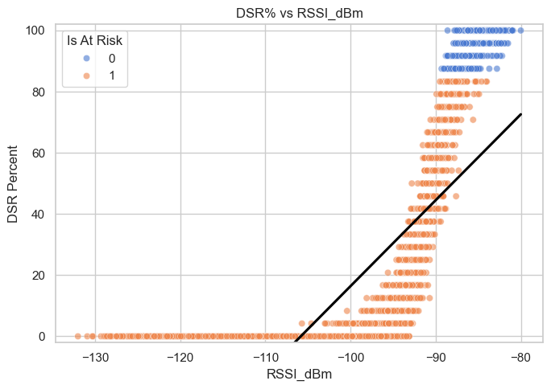
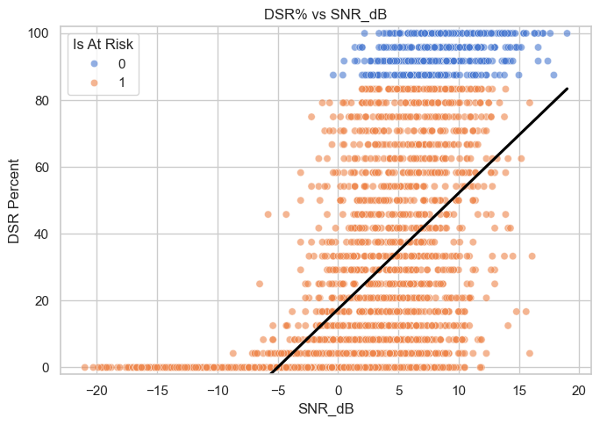
DSR relates to RSSI_dBm and SNR_dB

Slide 12
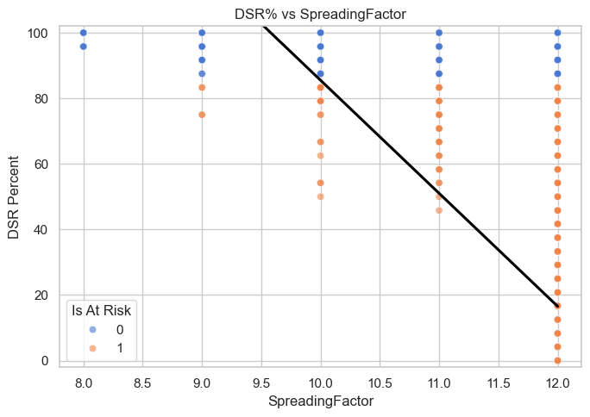
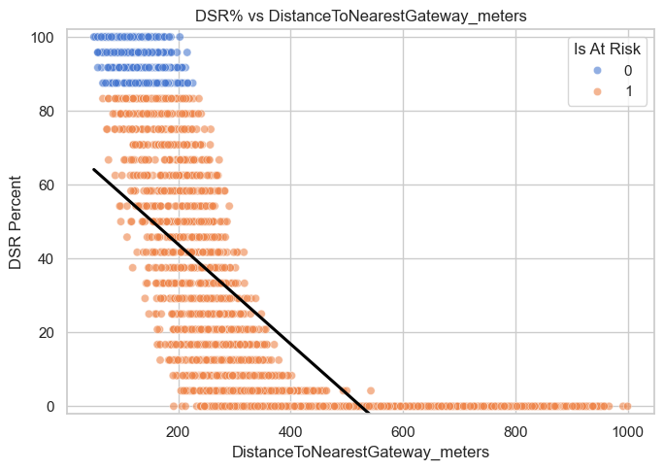
DSR relates to SpreadingFactor and DistanceToNearestGateway_meters

Slide 13
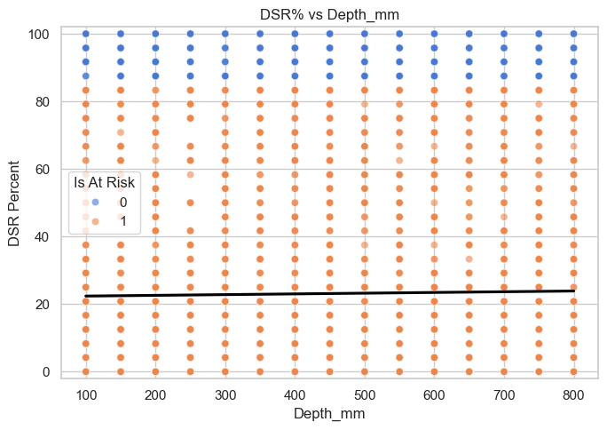
DSR relates to Depth_mm

Slide 14
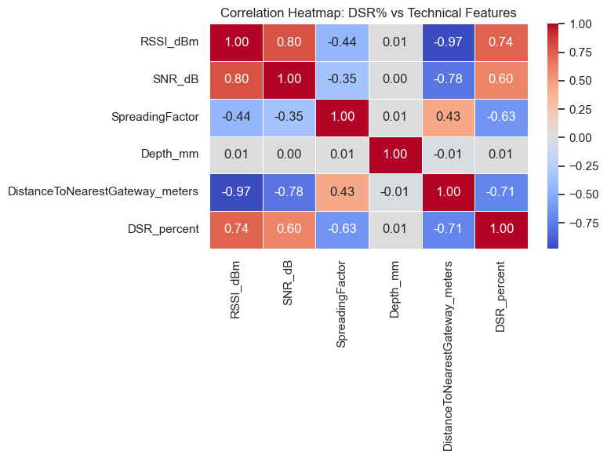
Correlation Matrix between DSR and Features

Slide 15
Preprocessing Data Before Training a Predictive Model
Dropped Columns Before Training Predictive Model:
'MeterID', 'Latitude', 'Longitude 'ExpectedReads', 'ActualReads’,
Features for Predictive Model Training:
'LidType', 'RSSI_dBm', 'SNR_dB', 'SpreadingFactor’, 'DistanceToNearestGateway_meters', 'DSR_percent', 'Depth_mm’,
New Column Created for Target Variable:
'IsAtRisk’ = DSR_Percent<85%

Slide 16
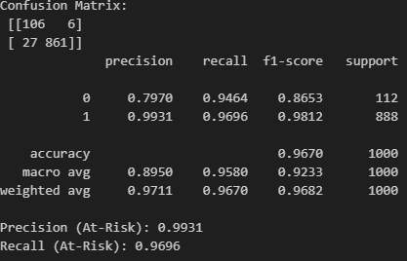
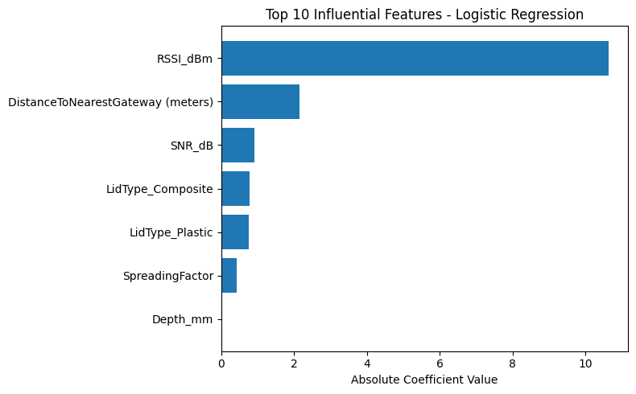
Logistic Regression Evaluation Matrix:
Feature Importance According to Logistic Regression
For Logistic Regression:
Recall (At-Risk): 0.9696

Slide 17
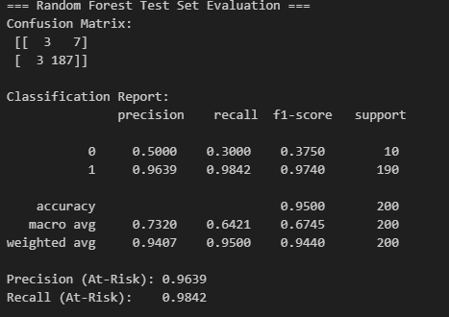
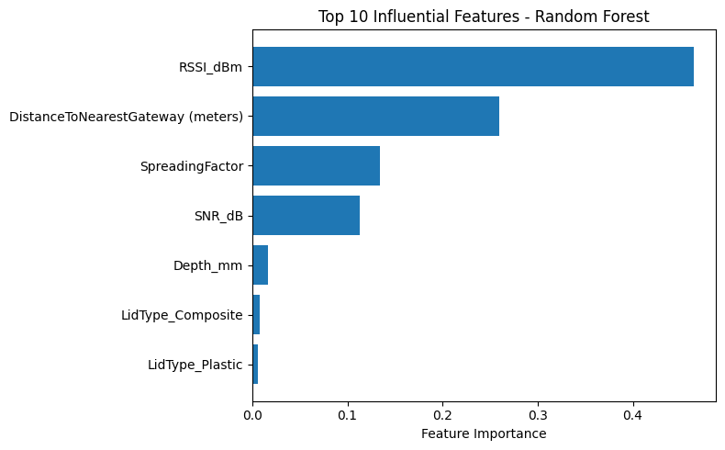
Random Forest Classifier Evaluation Matrix:
For Random Forest Model:
Recall (At-Risk): 0.9895
Feature Importance According to Random Forest Classifier

Slide 18
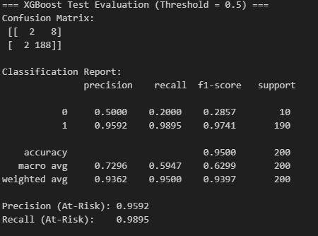
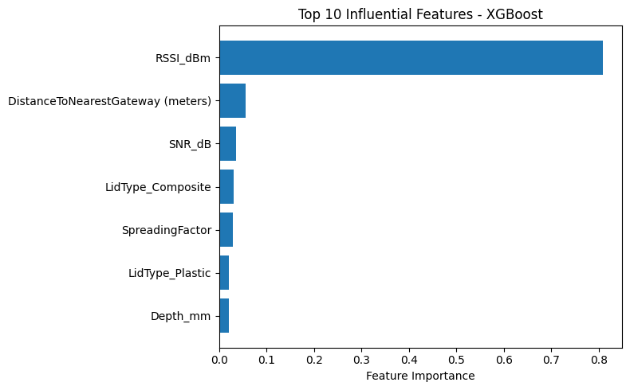
XGB Classifier Evaluation Matrix:
For XGB Model:
Recall (At-Risk): 0.9895
Feature Importance According to XGB Classifier

Slide 19
Conclusion:
Features that are affecting the DSR Percent and IsAtRisk Column are:
RSSI_dBm Best Value[ -87 dBm to -75dBm ]
SNR_dB Best Value[ 5 dB to 15 dB]
Spreading Factor Best Value [7 to 11]
DistanceToNearestGateway_meters Best Value [0 m – 200 m]

Slide 20

Thank You
Dominic Murphy
Director of International Delivery
Netmore Group
Kamran Nawaz
Technical Lead (LoraWAN)
Netmore Group

